Slide 1

Docker in production? Done that, what’s next?

Slide 2
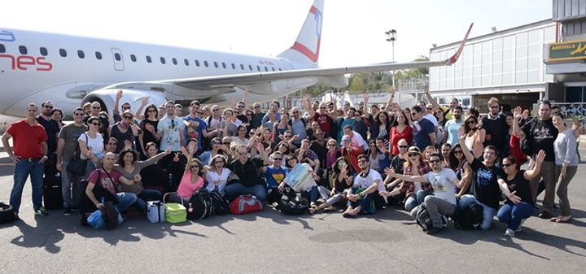
What Frog?

Slide 3
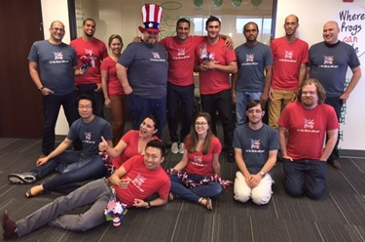
What Frog?

Slide 4
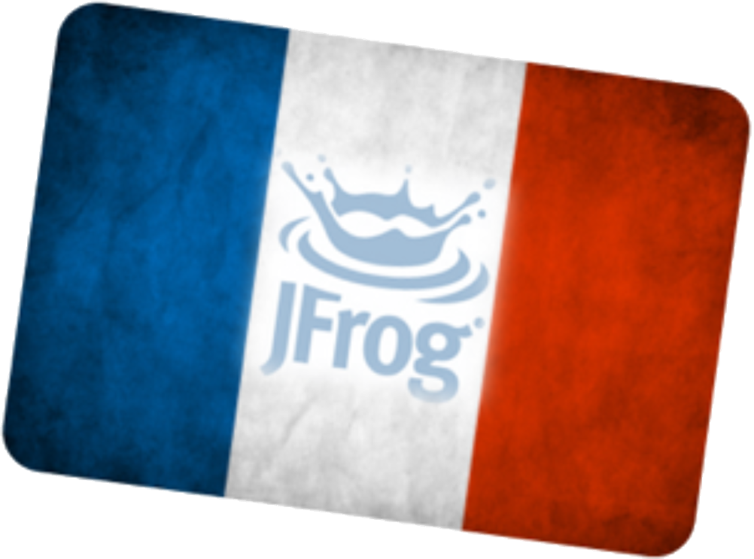
What Frog?

Slide 5
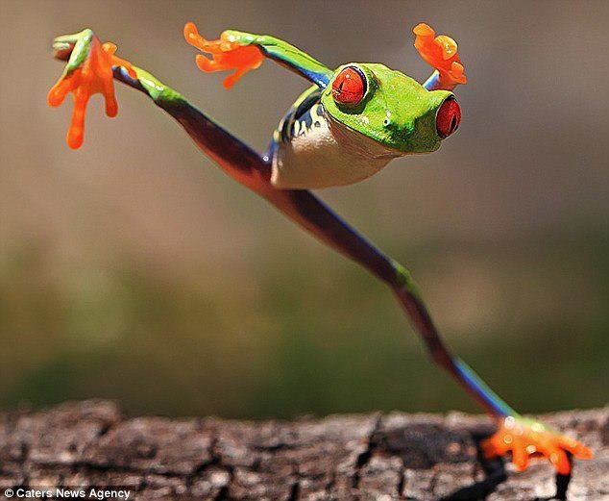
What Frog?

Slide 6
JFrog Platform + Docker

Slide 7
Trust me, I’m a
Chef Arhitect
Chief Archetect
Shef Archetecte
I’m good with Docker

Slide 8
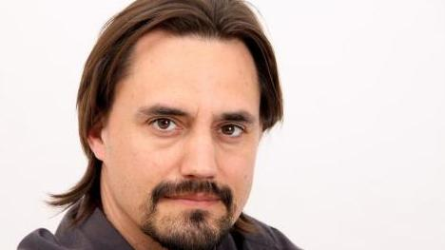
whois
Fred Simon, JFrog co-founder and Chief Architect
@freddy33
Notes:
Going to talk about JFrog in 2 slides
Going to talk about why DevOps in 3 slides
Going to talk about Artifactory next

Slide 9

Why we are good with docker

Slide 10
Why we are good with docker
- we have decade of experience with managing binaries

Slide 11
Why we are good with docker
- we have decade of experience with managing binaries
- We did image registry before there was docker registry

Slide 12
Why we are good with docker
- we have decade of experience with managing binaries
- We did image registry before there was docker registry
- we did private image hosting before docker hub

Slide 13
Why we are good with docker
- we have decade of experience with managing binaries
- We did image registry before there was docker registry
- we did private image hosting before docker hub
- we do promotion pipelines for docker

Slide 14
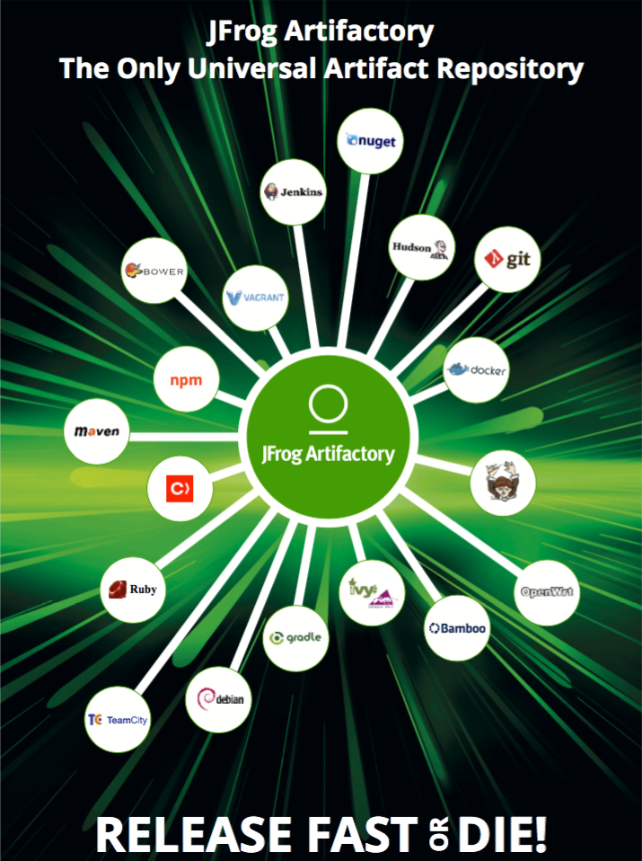
Problem?

Slide 15
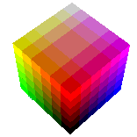

Slide 16
From: <Sales Team>
To: <Solution Engineering Team>
Subject: Pre Sales for Acme Corp
Date:
Attendees:
Requirements:
Artifactory HA clusters at 3 different locations
Tools and environment:
Jenkins (2 locations), TeamCity (1 location)
Git with workflows
Android dev with Gradle, JS dev with Bower, also a bit of Rubygems and .Net with NuGet. Heavy Docker.

Slide 17
From: <Sales Team>
To: <Solution Engineering Team>
Subject: Pre Sales for Acme Corp
Date:
Attendees:
Requirements:
Artifactory HA clusters at 3 different locations
Tools and environment:
Jenkins (2 locations), TeamCity (1 location)
Git with workflows
Android dev with Gradle, JS dev with Bower, also a bit of Rubygems and .Net with NuGet. Heavy Docker

Slide 19
- 6 Artifactory instances with replication

Slide 20
- 6 Artifactory instances with replication
- NFS

Slide 21
- 6 Artifactory instances with replication
- NFS
- NGINX

Slide 22
- 6 Artifactory instances with replication
- NFS
- NGINX
- MYSQL

Slide 23
- 6 Artifactory instances with replication
- NFS
- NGINX
- MYSQL
- Gitlab

Slide 24
- 6 Artifactory instances with replication
- NFS
- NGINX
- MYSQL
- Gitlab
- 2 ci servers

Slide 25
- 6 Artifactory instances with replication
- NFS
- NGINX
- MYSQL
- Gitlab
- 2 ci servers
- demo projects for 4 technologies

Slide 26


Slide 27
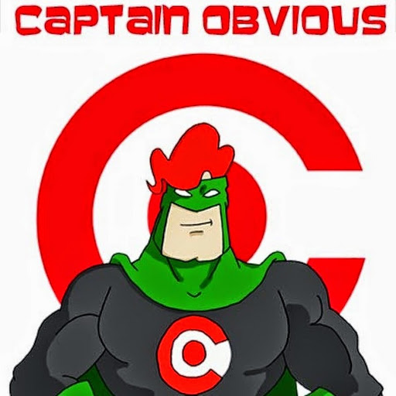
This image is found in the Internet by searching for “Capitan Obvious”. But you already knew that. Or not.

Slide 28
Solution | Pros | Cons
VM per tool | Sane number of VMs | 13 VMs to run the demo for Acme Cross–VM networking Orchestration
VM per setup | One VM per demo - can run on one machine | Insane number of VMs to create and maintain
Docker image per tool | Sane number of images 13 Lightweight containers can run on one machine Docker compose to orchestrate | Docker?

Slide 29
Solution | Pros | Cons
VM per tool | Sane number of VMs | 13 VMs to run the demo for Acme Cross–VM networking Orchestration
VM per setup | One VM per demo - can run on one machine | Insane number of VMs to create and maintain
Docker image per tool | Sane number of images 13 Lightweight containers can run on one machine Docker compose to orchestrate | Docker?

Slide 30
Solution | Pros | Cons
VM per tool | Sane number of VMs | 13 VMs to run the demo for Acme Cross–VM networking Orchestration
VM per setup | One VM per demo - can run on one machine | Insane number of VMs to create and maintain
Docker image per tool | Sane number of images 13 Lightweight containers can run on one machine Docker compose to orchestrate | Docker?

Slide 31
Solution | Pros | Cons
VM per tool | Sane number of VMs | 13 VMs to run the demo for Acme Cross–VM networking Orchestration
VM per setup | One VM per demo - can run on one machine | Insane number of VMs to create and maintain
Docker image per tool | Sane number of images 13 Lightweight containers can run on one machine Docker compose to orchestrate | Docker?

Slide 32

Docker-compose FTW?

Slide 33
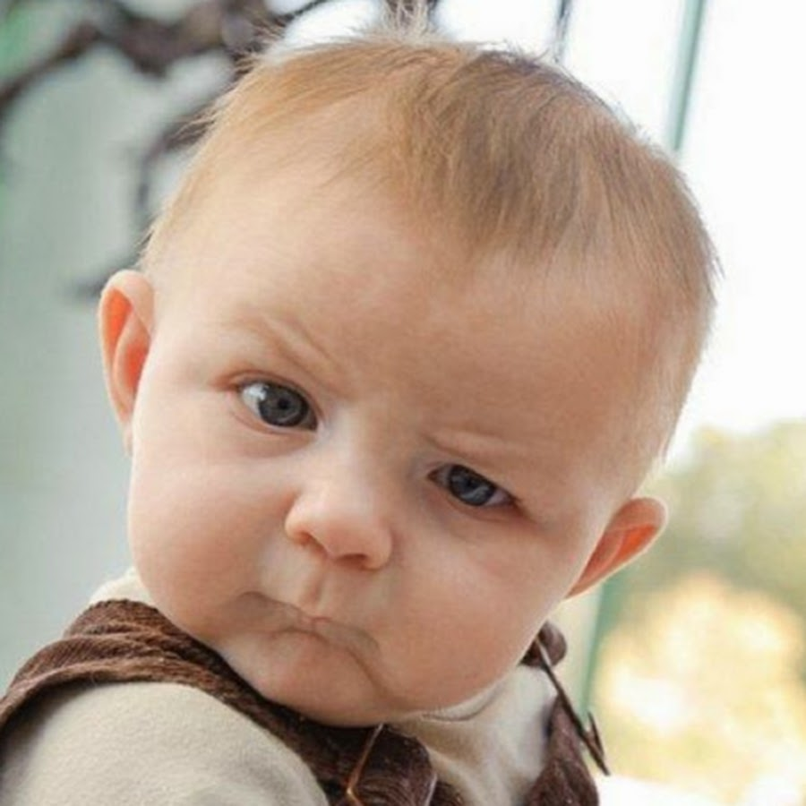
I am pretty sure
Abstract mentioned kubernetes

Slide 34
Client tools

Slide 35
Client tools
- brew install go

Slide 36
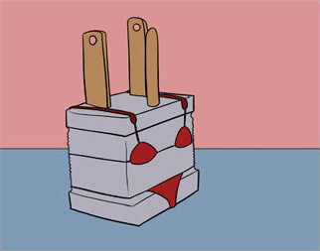

Slide 37
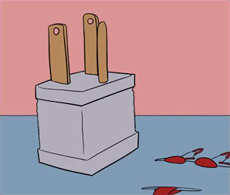

Slide 38
brew install go ==> Downloading https://homebrew.bintray.com/bottles/go-1.5.2.el_capitan.bottle. ######################## 33.3%

Slide 39
Client tools
- brew install go
- sdk install gradle

Slide 40
Client tools
- brew install go
- sdk install gradle
- rvm install 2.1.1

Slide 41
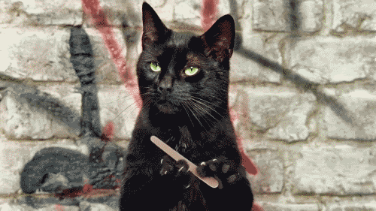
That was too easy
Is it docker-compose 101 talk?

Slide 42
Remember this?

Slide 43
Support tickets use case

Slide 44
Support tickets use case
- Same matrix: artifactory setup, ci ser,ver, build tools, etc.

Slide 45
Support tickets use case
- Same matrix: artifactory setup, ci ser,ver, build tools, etc.
- plus: managing the exact state to reproduce the problem

Slide 46


Slide 47
Volume management in docker

Slide 48
Volume management in docker
- best practices

Slide 49
Volume management in docker
- best practices
- management

Slide 50
Volume management in docker
- best practices
- management
- unmounting

Slide 51
Volume management in docker
- best practices
- management
- unmounting
- versioning

Slide 52
Volume management in docker
- best practices
- management
- unmounting
- versioning
- metadata

Slide 53
Volume management in docker
- best practices
- management
- unmounting
- versioning
- metadata
- What’s in image, what’s in volume?

Slide 54

I like you
But I don’t trust you

Slide 55
Correlation with ticket

Slide 56
Correlation with ticket
- ticket describes state
- ticket num in support system

Slide 57
Correlation with ticket
- ticket describes state
- ticket num in support system
– set of containers
- docker compose file in git
- docker images in artifactory

Slide 58
Correlation with ticket
- ticket describes state
- ticket num in support system
– set of containers
- docker compose file in git
- docker images in artifactory
- set of volumes
- ?

Slide 59
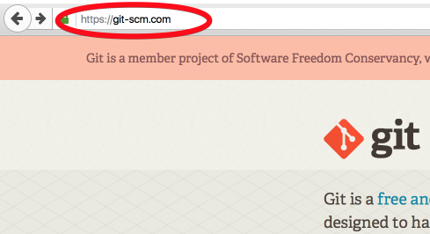

Slide 60
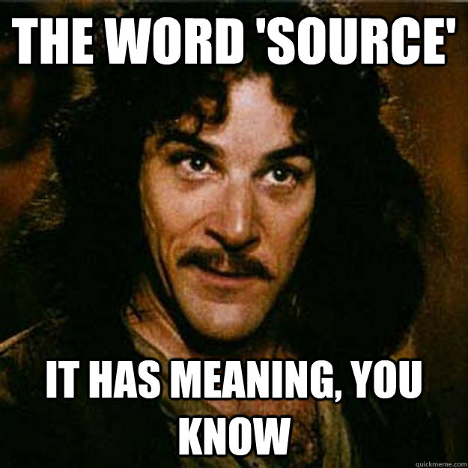

Slide 61
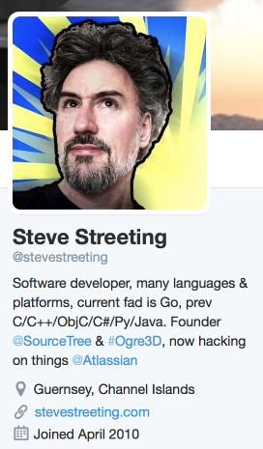
Git and Large Files
“…frequent problems…because of large files clogging up [Git] repositories, slowing everything down, and making clone sizes intolerable…
https://developer.atlassian.com/blog/2015/10/contributing-to-git-lfs/

Slide 62
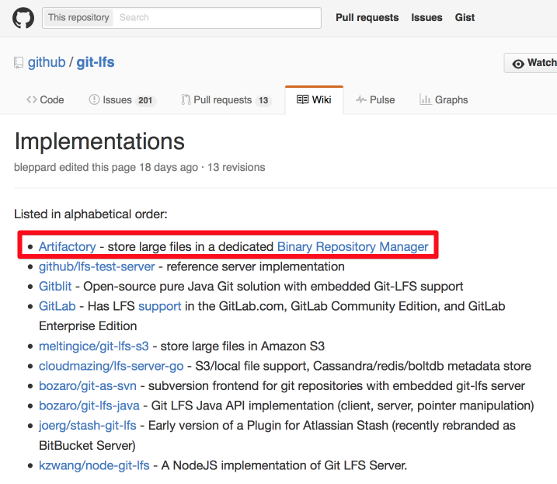
Git LFS to the Rescue

Slide 63
Correlation with ticket
- ticket describes state
- ticket num in support system
– set of containers
- docker compose file in git
- docker images in artifactory
- set of volumes
- in artifactory via git-lfs

Slide 64

Demo Time!

Slide 65
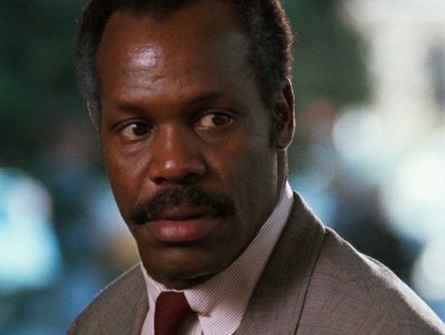
If you know what cruisecontrol is
You’re too old for this S*

Slide 66
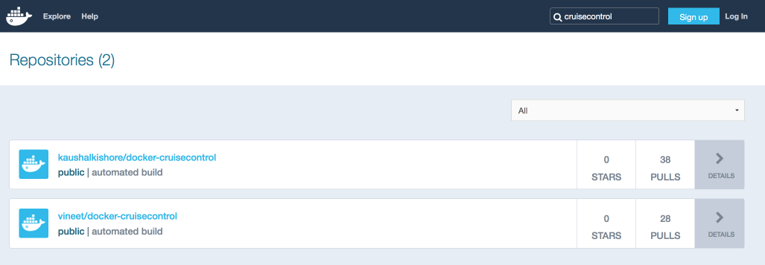
https://hub.docker.com/r/kaushalkishore/docker-cruisecontrol/~/dockerfile/

Slide 67
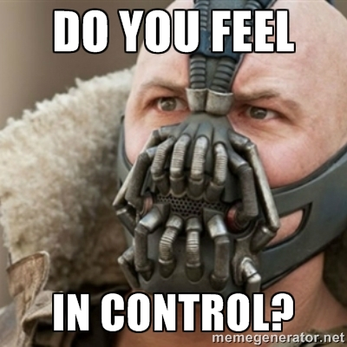

Slide 68
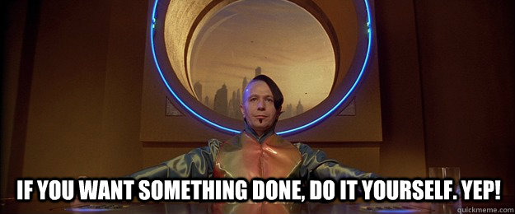

Slide 69
Ensuring Control
FROM myartifactory/ubuntu:14.04
ADD http://myartifactory:8081/artifactory/config/sources.list /etc/apt/sources.list
RUN apt-get update && apt-get install apt-get install openjdk-7-jdk

Slide 70
Ensuring Control
Always use trusted source for images
FROM myartifactory/ubuntu:14.04
ADD http://myartifactory:8081/artifactory/config/sources.list /etc/apt/sources.list
RUN apt-get update && apt-get install apt-get install openjdk-7-jdk

Slide 71
Ensuring Control
Always use trusted source for images
Always use specific version of dependencies
FROM myartifactory/ubuntu:14.04
ADD http://myartifactory:8081/artifactory/config/sources.list /etc/apt/sources.list
RUN apt-get update && apt-get install apt-get install openjdk-7-jdk

Slide 72
Ensuring Control
Always use trusted source for images
Always use specific version of dependencies
Always use trusted source for packages
FROM myartifactory/ubuntu:14.04
ADD http://myartifactory:8081/artifactory/config/sources.list /etc/apt/sources.list
RUN apt-get update && apt-get install apt-get install openjdk-7-jdk

Slide 73

No, thank you!

